Slide 1

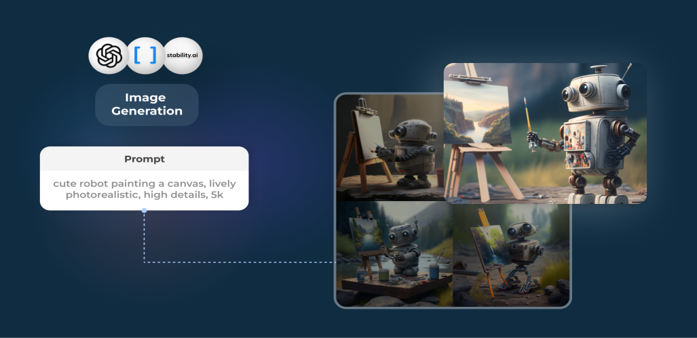
N.B.K.R INSTITUTE OF SCIENCE & TECHNOLOGY
(AUTONOMOUS)
TEXT TO IMAGE GENERATION USING GAN
PRESENTED BY
-
-
-
-
20KB1A3034
P. YUVARAJ
V.SAI LEKHYA
S.V.SURYA NARAYANA
SK.ROSHINI
20KB1A3060
20KB1A3051
20KB1A3050
UNDER THE GUIDANCE OF
Mrs M.SUJANA M.Tech, [Ph.D]
Assistant Professor
Department of IT and AI&DS
Batch No : 09

Slide 2
Exploring Text-to-Image Generation with GAN
Introduce the project's core objective is to delve into the domain of text-to-image synthesis leveraging Generative Adversarial Networks (GANs).
Highlight the growing significance of generating realistic images from textual descriptions in the field of deep learning and computer vision.
Address the broader context of GANs, known for their ability to produce visually compelling content through adversarial training.
Establish the motivation for the project, emphasizing the challenges and opportunities in the synthesis of images from textual data.

Slide 3
Literature Survey on Text-to-Image Generation
Present a comprehensive review of existing research in the field of text-to-image synthesis.
Explore seminal works and advancements in Generative Adversarial Networks (GANs) applied to image generation from textual descriptions.
Discuss key findings regarding model architectures, training strategies, and evaluation metrics used in the literature.
Highlight notable challenges and breakthroughs, providing insights into the evolution of techniques for bridging the gap between language and image synthesis.

Slide 4
Key Parameters in Text-to-Image Synthesis
Dataset Selection
Model Architecture
Text Representation
Training Hyper parameters
Evaluation Metrics
Fine-Tuning Strategies
Computational Resources
Data Augmentation Techniques
Ethical Considerations

Slide 5
Methodology Architecture : GAN
Generative Aspect: This network takes text as input and transforms it into data that be similar to the training dataset.
The goal is to generate realistic samples that are indistinguishable from real data.
Adversarial Aspect: The discriminator learns to distinguish between real and generated data. the discriminator aims to become more expert at
telling real from fake. This adversarial process results in the generator continually improving its ability to generate realistic data.

Slide 6
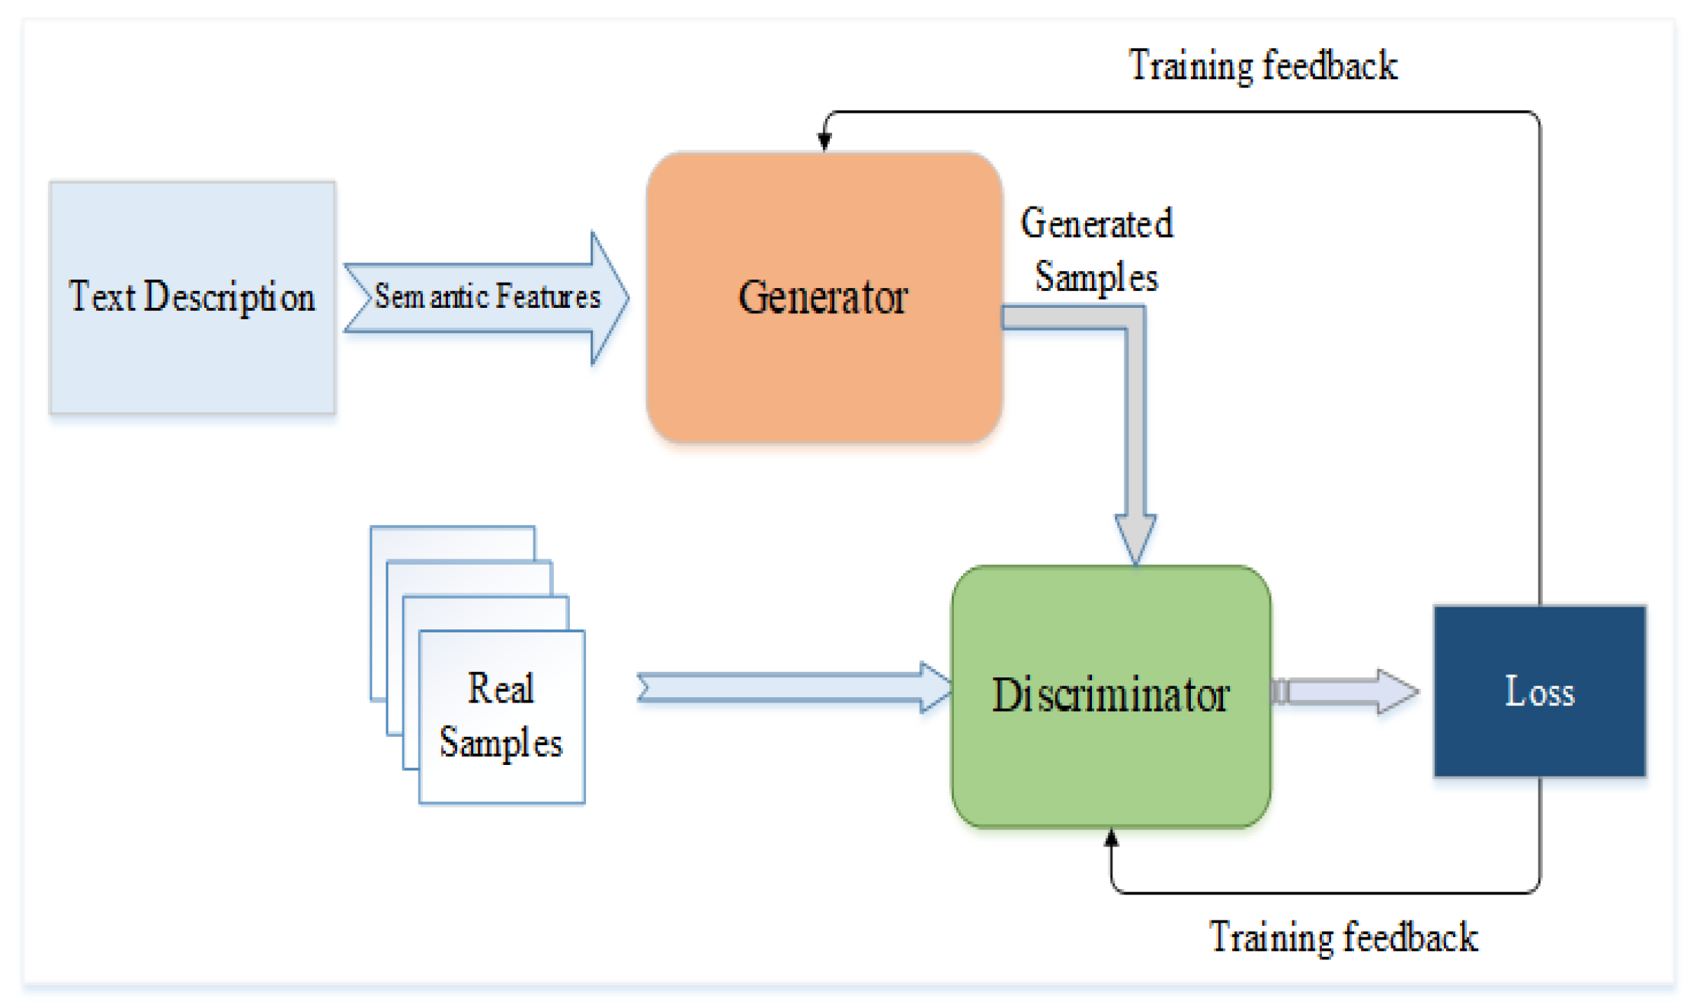

Slide 7
Implementation Procedure
Dataset Preparation
Text Data Preprocessing
Image Resizing
Model Architecture Setup
Text-to-Image Mapping
Input Data Preparation
Training Configuration
Optimization
Visual Representation
Results Analysis

Slide 8
Expected Results
Creating realistic and high-quality images from text is a challenging task and typically falls under the domain of text-to-image generation models
some common expectations and challenges include:
Realism
Consistency
Diversity
Contextual Understanding
Handling Ambiguity

Slide 9
Results Analysis
When analyzing the results of a text-to-image generated model, several factors need to be considered to evaluate the performance. Here are some key aspects to consider:
Visual Quality:
Assess the visual quality of the generated images. Take a close look at the images. Look for details, sharpness, and realism.
Coherence with Text:
See if the images match what the text is given.

Slide 10
Conclusion
In the fields of computer vision and natural language processing, text-to-image generation is a hot topic these days. For producing visually realistic and semantically consistent images, we presented a deep learning-based model and described how it works in the confluence of computer vision and natural language processing.

Slide 11
THANK YOU

